Slide 1
Hexa-Hive Modular Pods

Slide 2
Motivation :
Spaces need to be flexible, modular, and adaptable to suit evolving needs.
Hexa‑Hive Modular Pods draw inspiration from nature’s hexagonal design for strength and efficiency.
Enables easy reconfiguration, expansion, and customization for labs, workspaces, or habitats.
Aims to optimize space usage while fostering collaboration, innovation, and sustainability.

Slide 3
Key Features of Hexa-Hive modular pods:
Hexagonal Modular Design: Each unit has a hexagonal shape, allowing them to fit together like a honeycomb (hence the name "Hexa-Hive"). This supports tight, space-efficient arrangements .
Modular and Expandable: The pods are designed to be connected to each other seamlessly. You can add or remove modules depending on the application. They connect via both magnetic and mechanical connectors, ensuring a firm yet flexible attachment.
Swappable Front Face : The front face of each module can be swapped out, allowing for different functionalities or designs. Could be useful for changing sensors, input/output devices, or other hardware interfaces.

Slide 4
Top Slot for Label/OLED : Each pod has a slot on the top surface for adding a label or an OLED display, making it easy to identify or monitor pod status.
Queen Node : A special labeled module, called the "Queen Node", possibly acts as a central control or master unit. It may contain the main processing or power distribution logic.
Magnetic + Mechanical Connectors : Uses both magnetic attraction (for easy alignment and connection) and mechanical latching (for stability). Facilitates fast reconfiguration and secure modular builds.

Slide 5
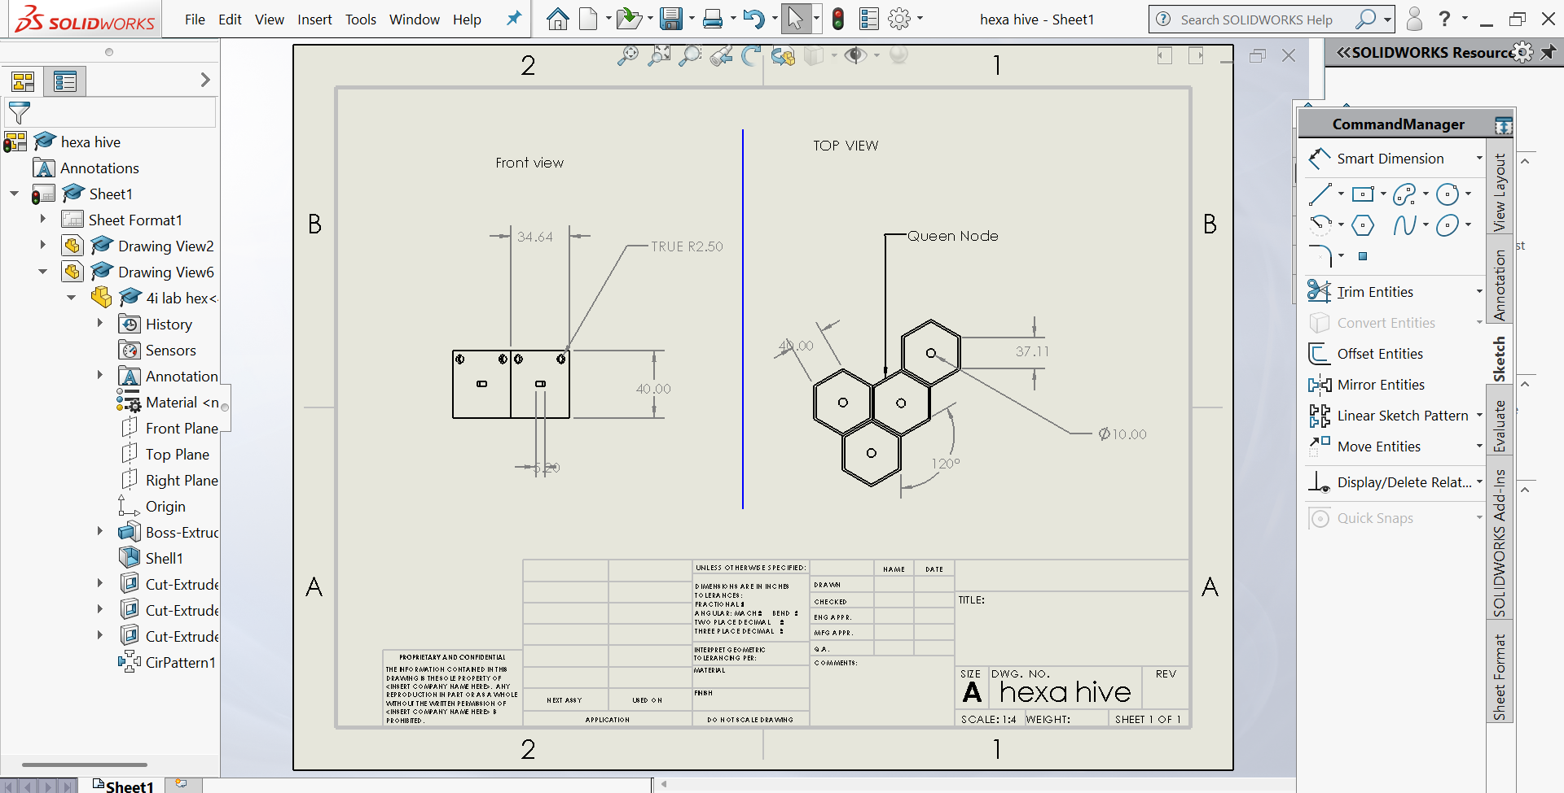
2D DRAWING:

Slide 6
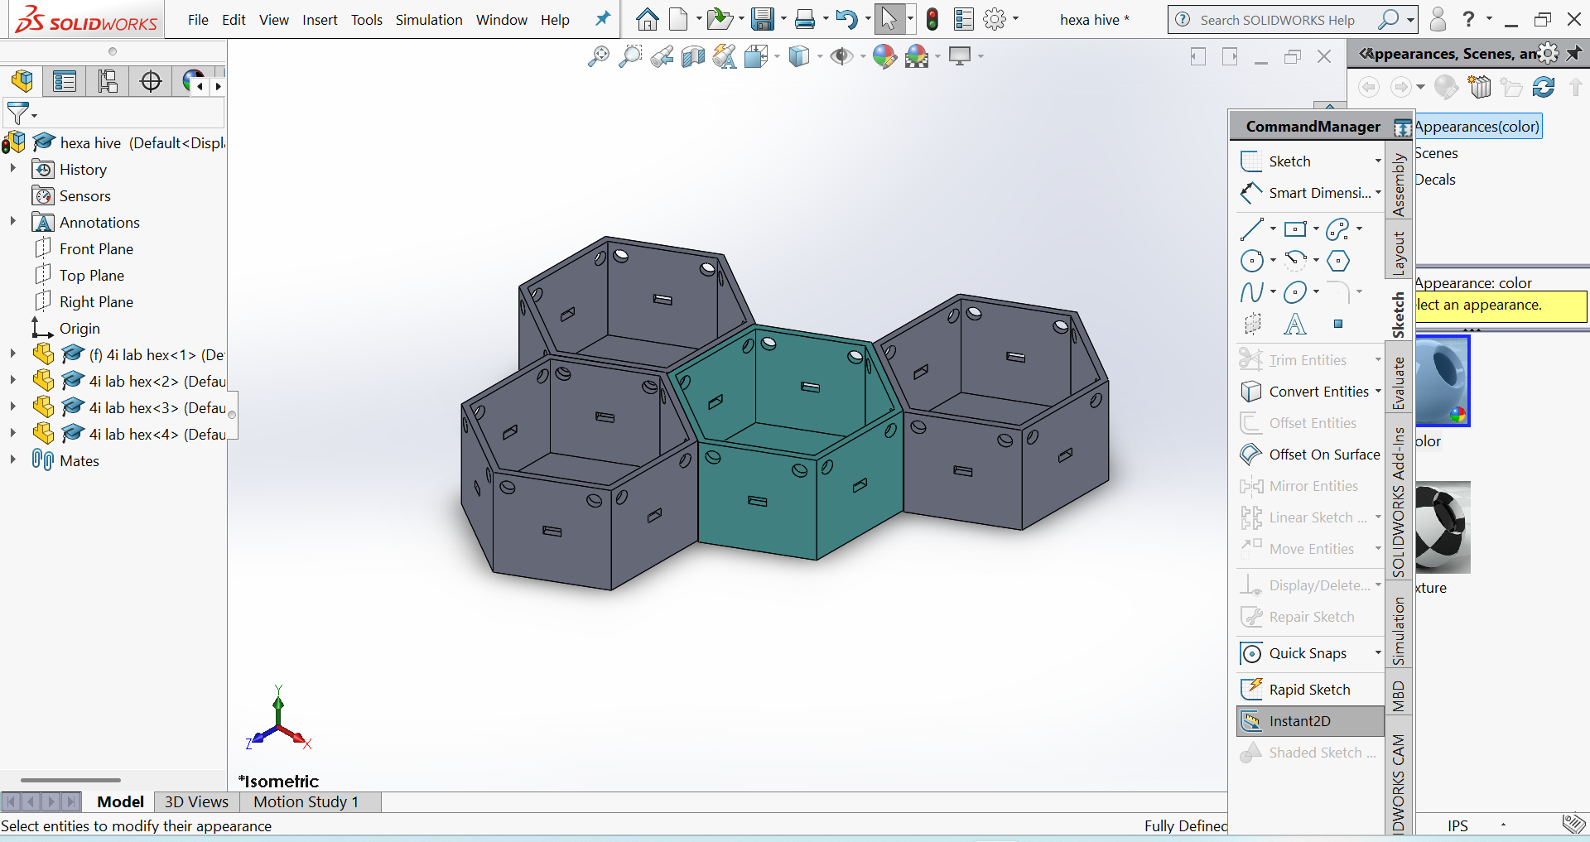
3D CAD MODEL:

Slide 7
Applications :
Research Labs : Modular spaces for experiments and equipment.
Office Spaces : Flexible workstations that can be added or reconfigured.
Living Units : Compact, adaptable pods for urban housing.
Vertical Farming : Stackable pods for agriculture and planting.
Space Habitats : Modular units for space stations and lunar habitats.
Industrial Use : Modular storage and assembly areas.

Slide 8
Material selection and Manufacturing Plan : Material choices:
COMPONENT | MATERIAL | REASON
Pod shell | PLA/ABS | Easy to 3D print , durable, cost effective
Face panel | Acrylic/PLA | Visibility + customization
Magnets | Neodymium | Strong , compact connectors
Inserts | Brass Threaded | For reusability and strength

Slide 9
Manufacturing plan:
Method : 3D printing(FDM)
Settings : layer height:0.2mm ,
Infill:20-30% ,
Supports: enabled for overhangs;
Assembly : Snap-in magnets,
Head set inserts for faceplate screws,
Optional silicone grommets for wire passthroughs ;
Finish : Light sanding+ matte spray point,
Label stickers for pod names.

Slide 10
Conclusion:
“The Hexa- Modular Pod offers a smart, adaptable, and space-efficient design
— combining strength, scalability, and seamless connectivity. It redefines
modular spaces for modern living and working, making it an ideal solution
for a sustainable and flexible future.”
Thank you………..
Presented by :
Bellamkonda Deepika

